Slide 1
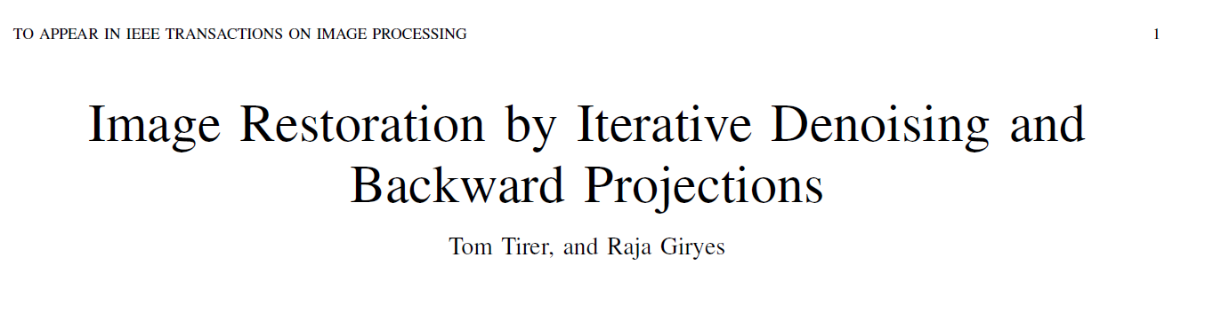
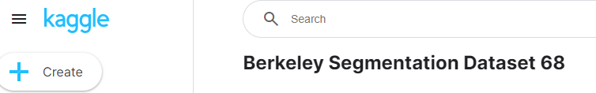
IDBP COMP 478 Group 11
Antoine Cantin 40211205
Ryan Li 40214839

Slide 2
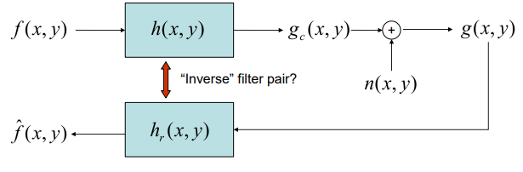
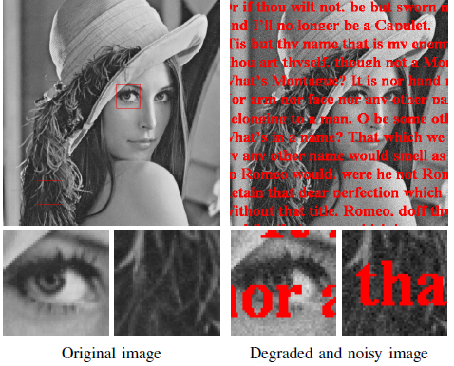
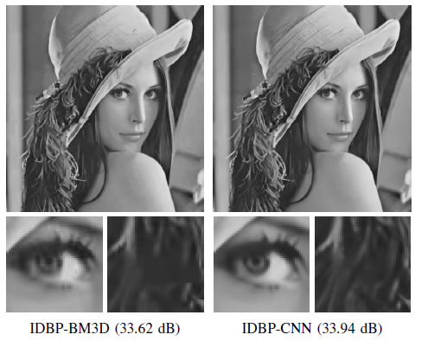
Paper’s published experiments

Slide 3
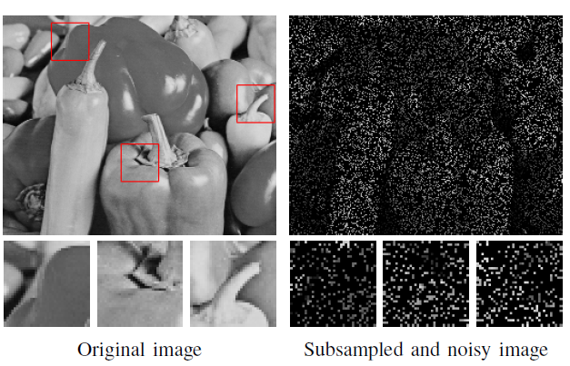
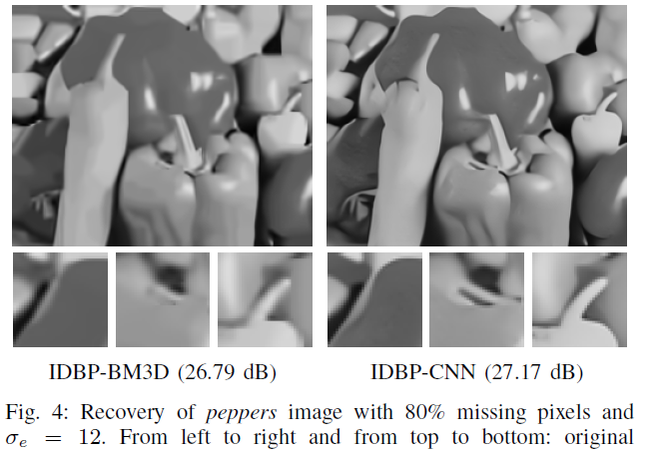
Paper’s published experiments

Slide 4
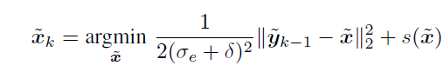
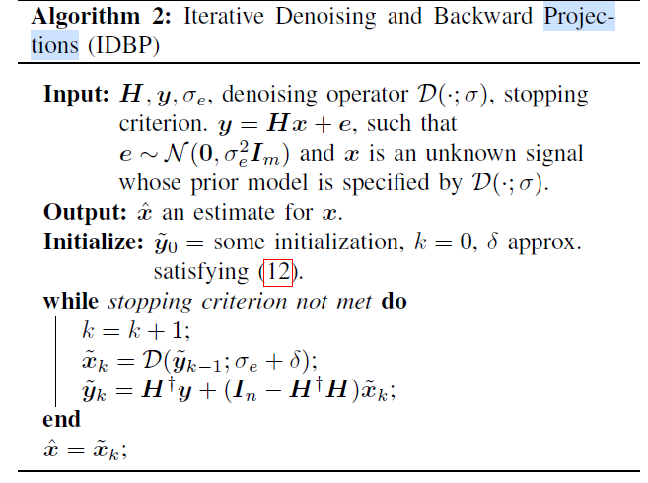








“Iterative Denoising and Backward Projections”
From an optimization (above in forward x projection form) inverse problem to an algorithm:
Iterate new estimates of the inverse problem by using a Denoiser (depends on parameter tuning and specific applications) of choice.
The backward/inverse aspect of the estimates as projections allows to reconstruct images based several equation models as well as characteristics from image priors, while barely changing any parameters (namely delta, sigma and noise model) (“Plug-and-Play”)
White Standardized Gaussian Noise
Denoiser in inverse problem

Slide 5
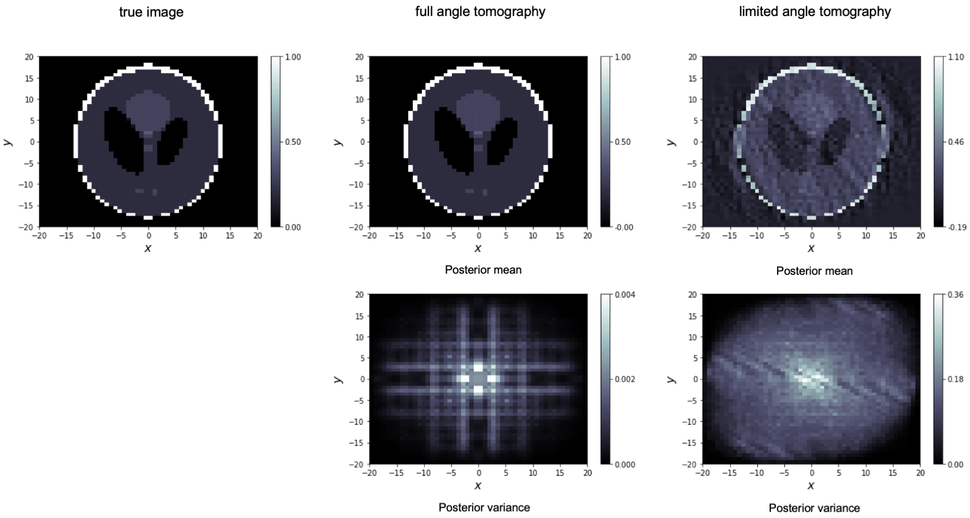
Inverse problems and Denoisers expanded for specific applications
denoising,
inpainting, and
deblurring an image
Can combine with Denoising Image Restoration Neural Networks
Or parameter auto-tuning
Or simply with off-the-shelf denoising operators
Plug and Play: quick and easy to use, intuitive and statistical parameter tuning
Notes:
https://www.damtp.cam.ac.uk/research/cia/inverse-problems-0

Slide 6
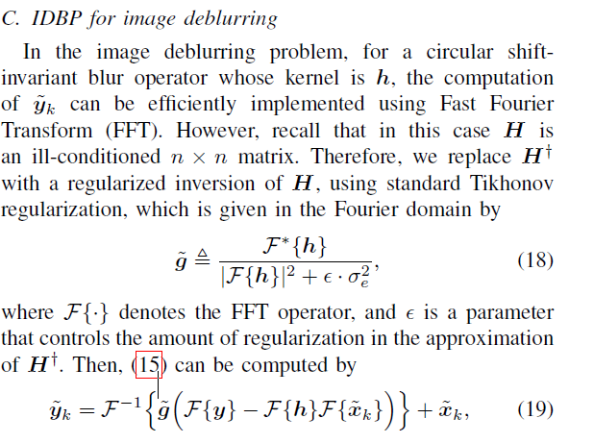
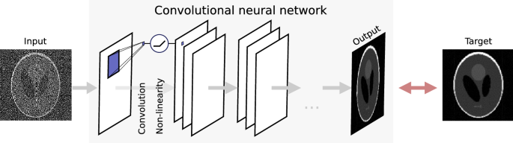
Inverse problems and Denoisers expanded for specific applications
denoising,
inpainting, and
deblurring an image
Can combine with Denoising Image Restoration Neural Networks
Or parameter auto-tuning
Or simply with off-the-shelf denoising operators
Plug and Play: quick and easy to use, intuitive and statistical parameter tuning
Notes:
https://www.nature.com/articles/s41598-021-91084-8

Slide 7
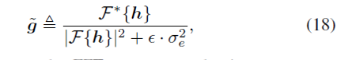
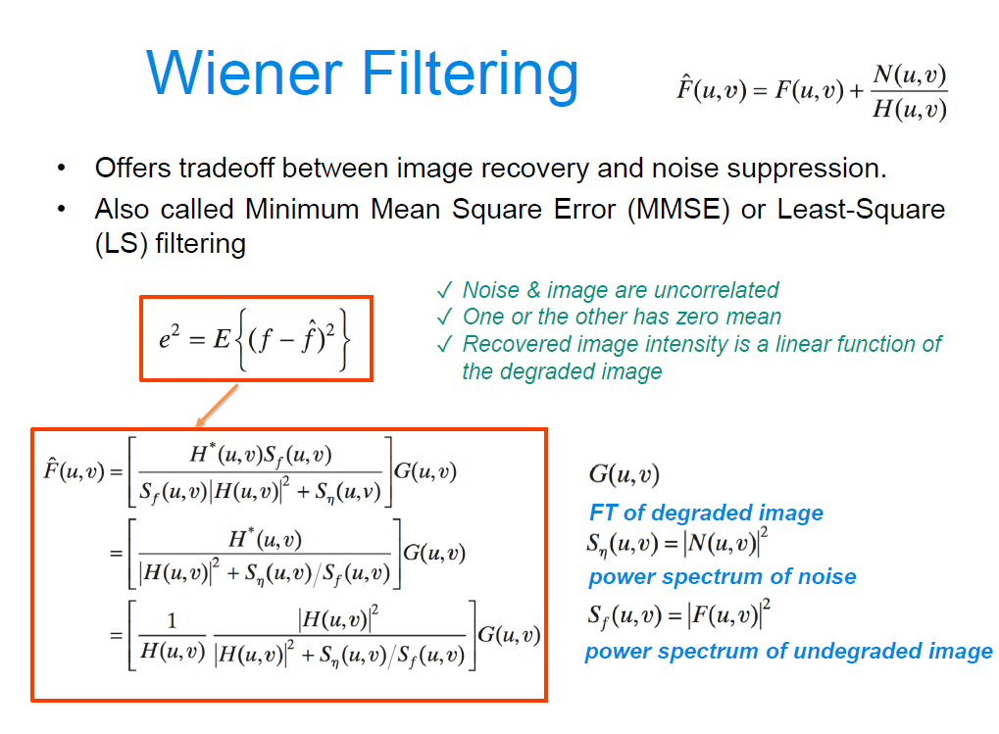
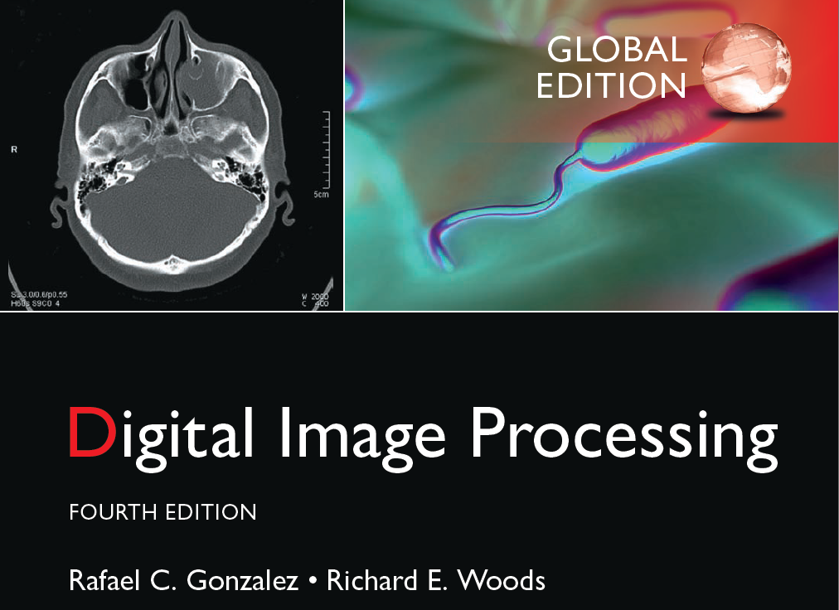
NOTE! Denoisers expanded for specific applications
IDBP’s Deblurring using Tikhonov regularization is a regularized least squares problems for circular shift-invariant filters.
While slightly more complex than the linear Least-Square filtering seen in the textbook, it is conceptually and mathematically close!

Slide 8
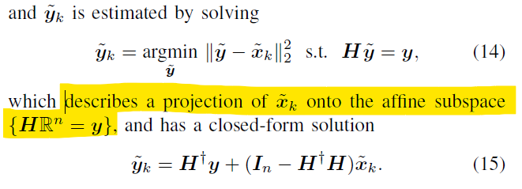
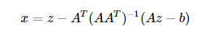
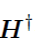
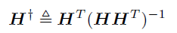
“Iterative Denoising and Backward Projections”
Estimates of the y used using reconstruction inputs is within a real linear manifold as a geometrical projection, implying that in its closed form, we can use it (with appropriate errors) in numerical methods and applications.
is used for pseudo-inverse filtering (pseudoinverse of full row rank matrix H). Even though degradation H is often nonlinear and uncertain in modeling, the computation of its “inverse” is easy as it only requires on 1 transposition and 1 matrix inversion on a (non-positive definite) square matrix

Slide 9
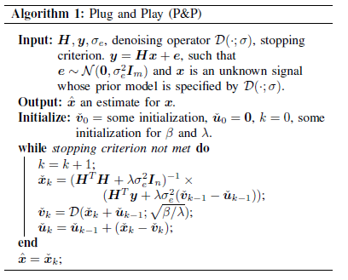
Problem Definition
Inverse Problem
Plug & Play used for:
Denoising,
Inpainting
Deblurring

Slide 10
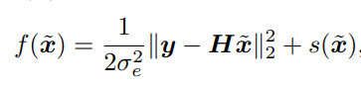
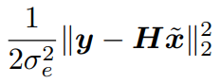
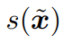
Loss Function
Purpose
Decouple both terms
Replace image prior with an off-the-shelf Denoising Operator
Image Prior
Measurement Mode

Slide 11
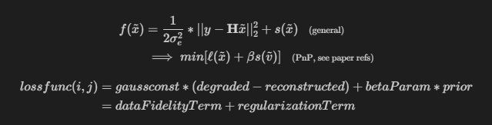
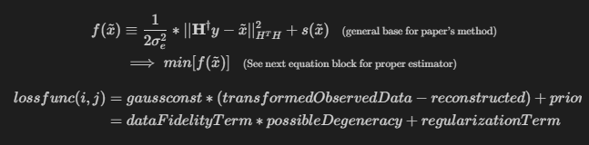
Loss Function
P&P
IDBP
Notes:
2 – 6 intro/problem definition

Slide 12
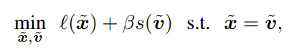
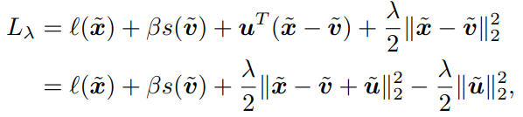
Issues:
When minimizing Loss Function:
2) Parameter Tuning is burdensome
Using ADMM (Alternative Direction Method of Multipliers) (augmented Lagrangian): Lots of iterates until convergence
Its components must be convex, closed, and proper. These properties are not ideal because most prior functions with off-the-shelf denoisers are non-convex and unclear.

Slide 13
Purpose of IDBP
Aims to proposes an efficient minimization scheme for the prior term using P&P properties to avoid these issues.
Automatic tuning mechanism for parameters that vary between noisy inpainting problems and deblurring automatic parameters.
Antoine Cantin 40211205
Ryan Li 40214839

Slide 14
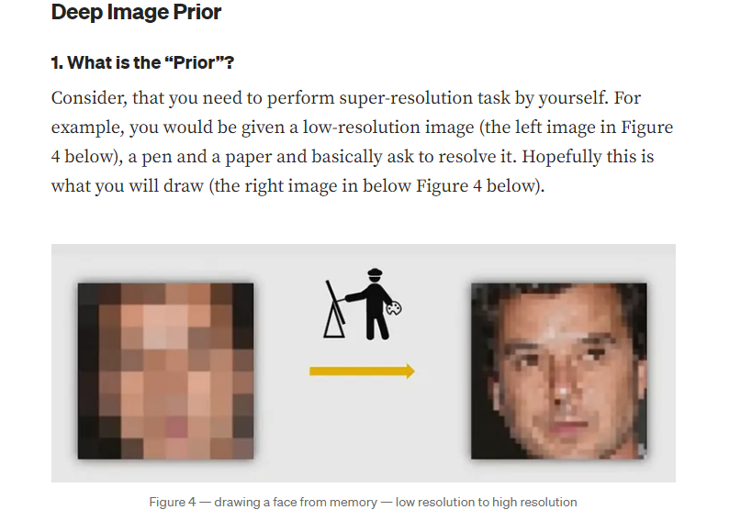
Priors
https://towardsdatascience.com/how-to-perform-image-restoration-absolutely-dataset-free-d08da1a1e96d
Notes:
https://towardsdatascience.com/how-to-perform-image-restoration-absolutely-dataset-free-d08da1a1e96d

Slide 15
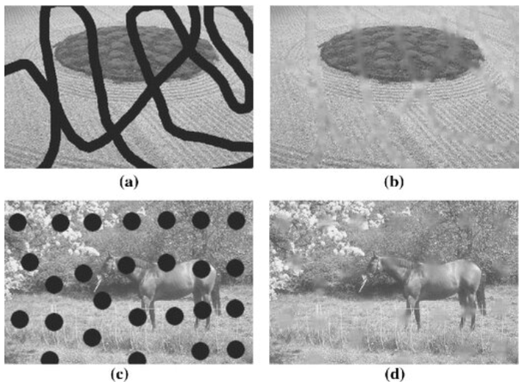
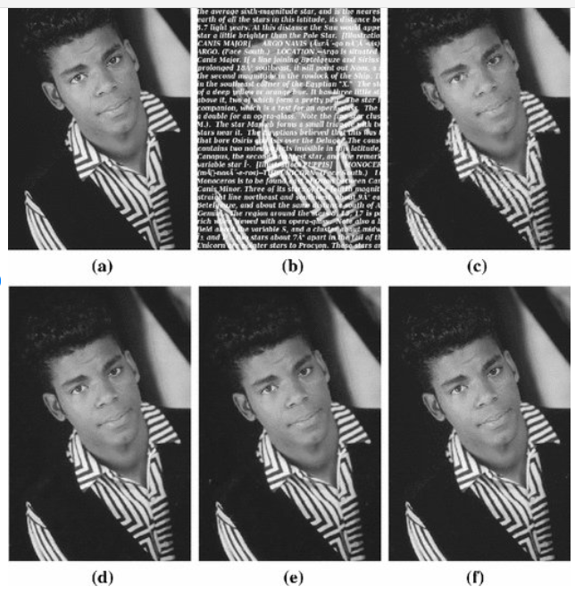
Our focus in our implementation and models: Inpainting
Notes:
https://www.researchgate.net/figure/a-Corrupted-image-with-thick-strokes-line-width-19-pixels-b-its-inpainted-image-via_fig3_287506575

Slide 16
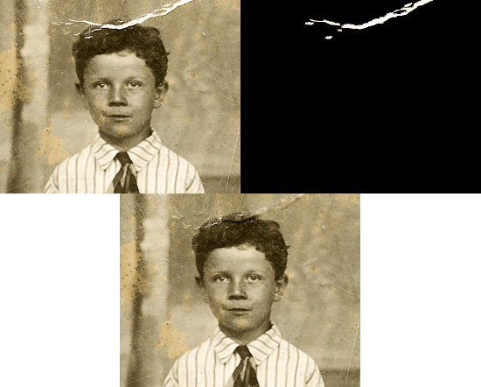
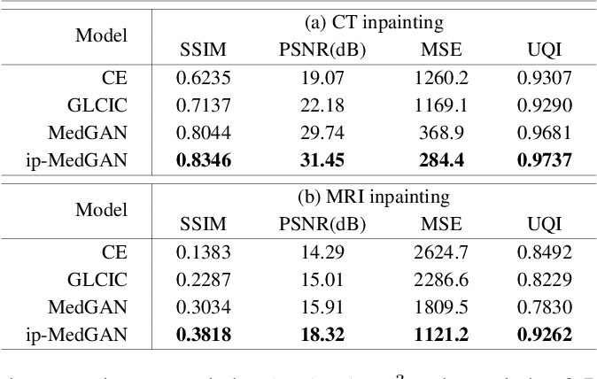
Our focus in our implementation and models: Inpainting
Notes:
https://pyimagesearch.com/2020/05/18/image-inpainting-with-opencv-and-python/
https://www.google.com/url?sa=i&url=https%3A%2F%2Fwww.semanticscholar.org%2Fpaper%2FAdversarial-Inpainting-of-Medical-Image-Modalities-Armanious-Mecky%2F8b3931990711a0963469b8fa16311814aaa8b3ab&psig=AOvVaw1ZxV5dCc0LkkYL2istDkiO&ust=1711777465765000&source=images&cd=vfe&opi=89978449&ved=0CBQQjhxqFwoTCPC4-Y_imIUDFQAAAAAdAAAAABBt

Slide 17
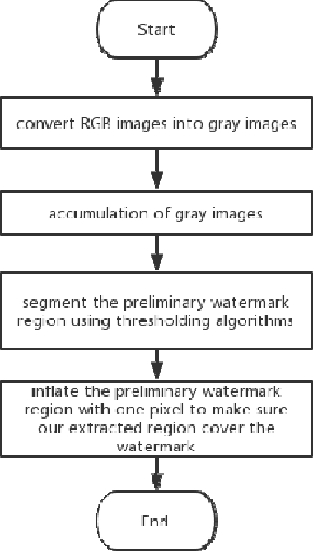
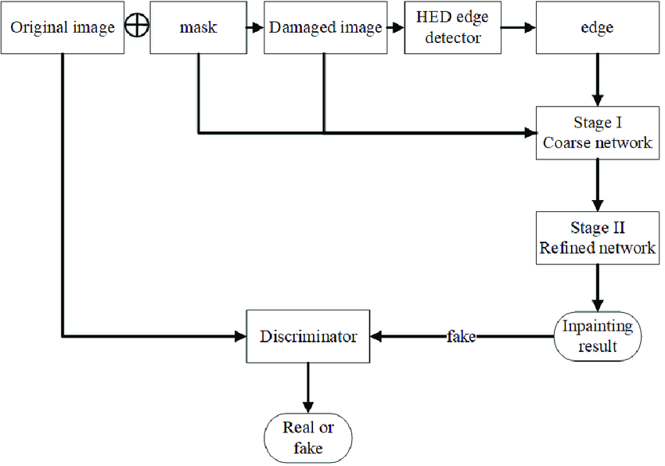
Our focus in our implementation and models: Inpainting
Notes:
https://www.google.com/url?sa=i&url=https%3A%2F%2Fwww.semanticscholar.org%2Fpaper%2FAn-automatic-visible-watermark-removal-technique-Xu-Lu%2Fe9a4d9462753cd79457e375901f19e76f023c685&psig=AOvVaw1ZxV5dCc0LkkYL2istDkiO&ust=1711777465765000&source=images&cd=vfe&opi=89978449&ved=0CBQQjhxqFwoTCPC4-Y_imIUDFQAAAAAdAAAAABB2
https://www.google.com/url?sa=i&url=https%3A%2F%2Fwww.researchgate.net%2Ffigure%2FSchematic-diagram-of-the-damaged-image-inpainting-process_fig4_369780859&psig=AOvVaw2Dmz_KRCm-wAVLGauIV2R0&ust=1711778329935000&source=images&cd=vfe&opi=89978449&ved=0CBQQjhxqFwoTCMDj_qvlmIUDFQAAAAAdAAAAABAf

Slide 18
Our focus in our implementation and models: Inpainting
Order statistic filter
Median on NaN pixels (observed image)
Neighboring NaN value not included
Kernel starts as 1x1 and increments after every pixel

Slide 19
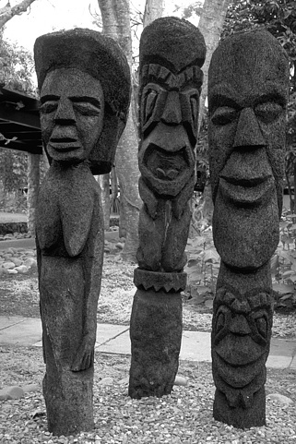
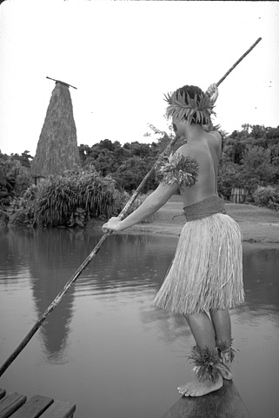
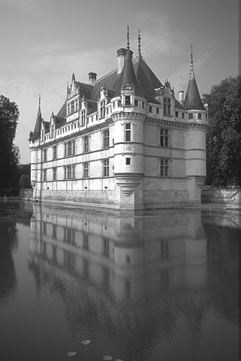
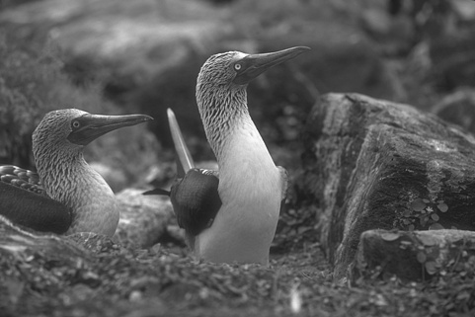
BSD68 Dataset
Consist of 68 grey-scale images (https://www.kaggle.com/code/mpwolke/berkeley-segmentation-dataset-68\)
Real-world images; better reflects real-world
Diverse set
Well-known
Good size for our purpose
Notes:
Dataset used

Slide 20
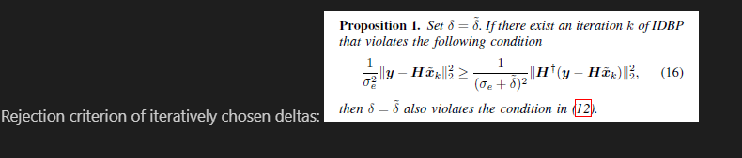
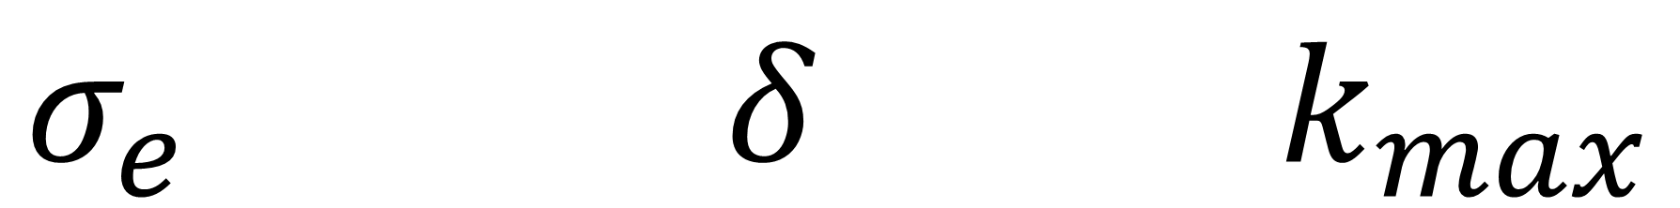
Parameter tuning and iteration criteria
$$σ_{e} δ k_{max}$$

Slide 21
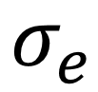
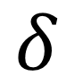
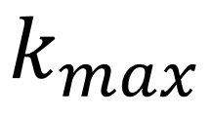
Parameter tuning and iteration criteria
Sigma_e
Standard deviation parameter of Gaussian distribution for random noise.
It is inversely proportional to severity of noise tolerance, in inpainting.
Higher value = smoother but accurate fidelity term
Lower value = more uncaught noise but more accurate fidelity term
MaxIter
Is the stopping criterion. Higher iterations will enhance convergence but with the cost of more computation time.
There looks to be a threshold beyond which additional iterations will yield diminishing returns.
Delta
Differential added to sigma_e
Balance effect of fidelity term and regulization term
Ensure feasibility of estimators

Slide 22
“Iterative Denoising and Backward Projections”
From an optimization (above in forward x projection form) inverse problem to an algorithm:
Iterate new estimates of the inverse problem by using a Denoiser (depends on parameter tuning and specific applications) of choice.
The backward/inverse aspect of the estimates as projections allows to reconstruct images based several equation models as well as characteristics from image priors, while barely changing any parameters (namely delta, sigma and noise model) (“Plug-and-Play”)
White Standardized Gaussian Noise
Denoiser in inverse problem

Slide 23
Tests – 2 Scenarios with missing pixels and Gaussian white noise
Scenario 1
Sigma e = 0
Max Iteration = 150
Delta = 5
Scenario 2
Sigma e = 10
Max Iteration = 75
Delta = 0

Slide 24
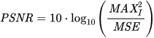
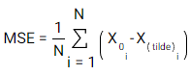
Metrics Used
PSNR (Peak Signal-to-Noise Ratio): compares mean squared root between the clean image and the restored image. Larger PSNR value indicates better image quality.
x_0 is the i-th pixel of clean image
x_tilde is i-th pixel of reconstructed image
N is total number of pixels
MAX is the max intensity level

Slide 25
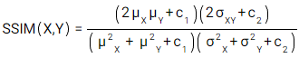
Metrics Used...
SSIM (Structural Similarity Index): compares structural similarity between clean image and the restored image. Larger SSIM value indicates greater similarities (SSIM > 1)
X is clean image
Y is restored image
µ_x, µ_y are mean intensities of both images respectively
σ^2 are variances of the images
σ_XY is the covariance of X and Y
c_1 and c_2 are constants to stabilize
c = (k)(MAX_Intensity)^2

Slide 26
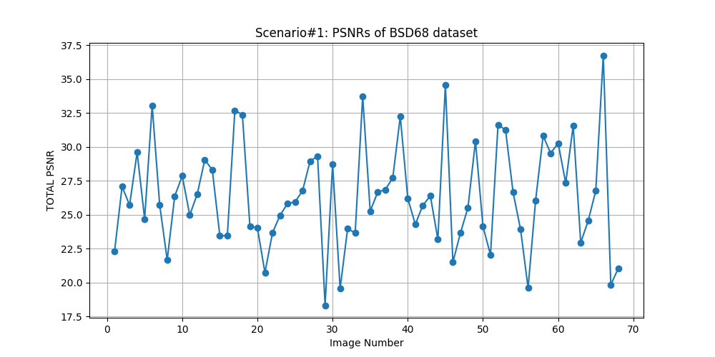

Slide 27
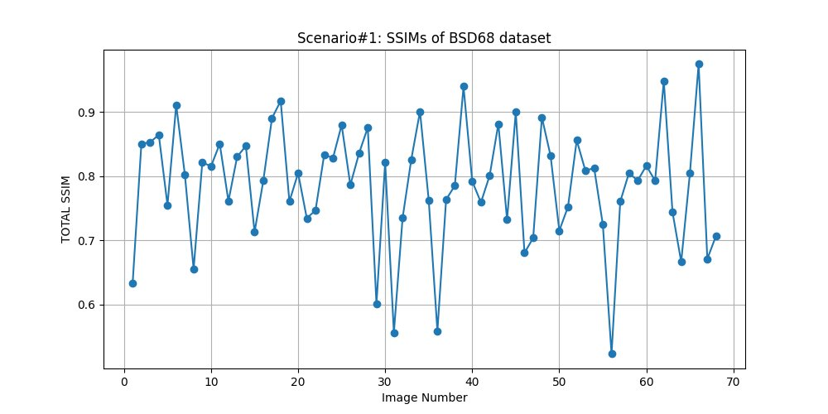

Slide 28
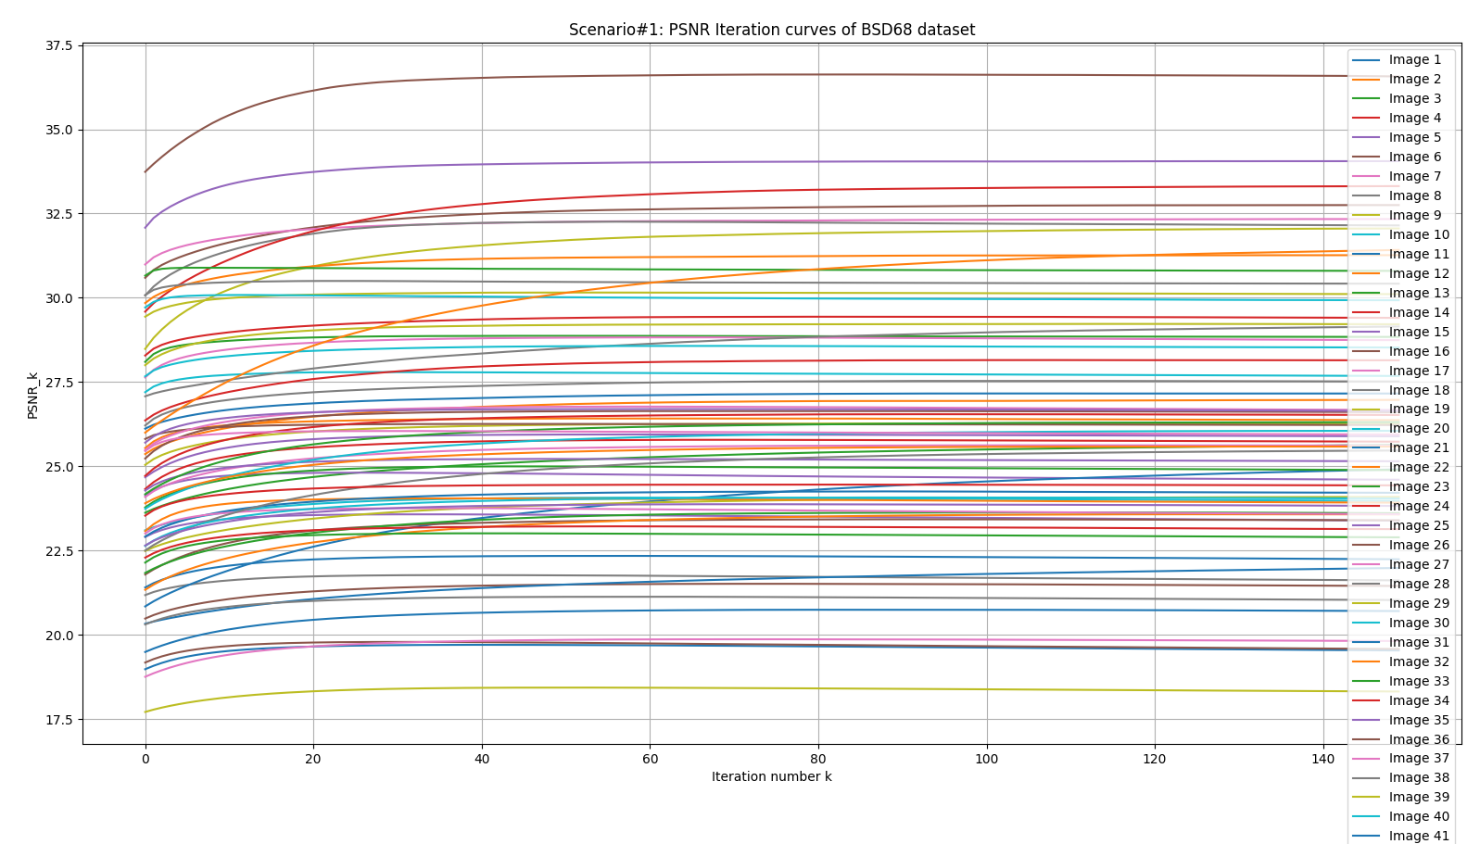

Slide 29
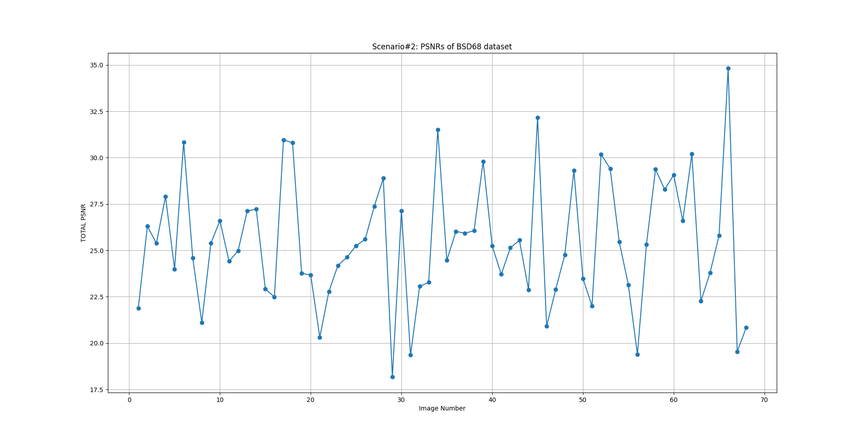

Slide 30


Slide 31


Slide 32


Example 1
Clean Image
Observed Image

Slide 33


Example 1
Scenario 1
Scenario 2

Slide 34


Example 2
Clean Image
Observed Image

Slide 35


Example 2
Scenario 1
Scenario 2

Slide 36


Example 3
Clean Image
Observed Image

Slide 37


Example 3
Scenario 1
Scenario 2

Slide 38


Example 4
Clean Image
Observed Image

Slide 39


Example 4
Scenario 1
Scenario 2

Slide 40

Example 5
Clean Image
Observed Image

Slide 41


Example 5
Scenario 1
Scenario 2

Slide 42


Next steps: Deblurring and New level of parameter tuning:
Notes:
https://www.researchgate.net/figure/Linear-image-degradation-model-caused-by-blurring-and-noise-Note-that-this-model_fig8_319701645

Slide 43



Next steps: Specific attention to priors’ model, classifications and usage
https://towardsdatascience.com/how-to-perform-image-restoration-absolutely-dataset-free-d08da1a1e96d
Notes:
https://towardsdatascience.com/how-to-perform-image-restoration-absolutely-dataset-free-d08da1a1e96d

Slide 44


Next steps: Specific attention to priors’ model, classifications and usage
https://towardsdatascience.com/how-to-perform-image-restoration-absolutely-dataset-free-d08da1a1e96d
Notes:
https://towardsdatascience.com/how-to-perform-image-restoration-absolutely-dataset-free-d08da1a1e96d

Slide 45
Next steps: Mix of small datasets for next Phase for categorized benchmarks
Verified, compression lossless, popular image restoration datasets that suit our testing and benchmarking purposes in next Phase:
Set12 (Smal, Very well established in quick testing and benchmarking in many applications, could be tuned for inpainting and compared with a lot of data available)
COCO (Objects in context; Multi-purpose proven both empirical and standardized in image restoration)
DAGM 2007/2009 (Common industrial defects... )
Others possible datasets and data sources:
https://www.imageprocessingplace.com/root_files_V3/image_databases.ht
http://pixel.essex.ac.uk/old-peipa/benchmark/databases/index.html#cbir
https://homepages.inf.ed.ac.uk/rbf/CVonline/Imagedbase.htm

Slide 46

Next steps: Mix of small datasets for next Phase for categorized benchmarks
Notes:
https://paperswithcode.com/dataset/coco

Slide 47

Next steps: New alternative datasets: samples of LSDIR
Standardization, Application specific ground truths,
Image restoration specific,
Worst model fits, Best Model fits, Average model fits
Notes:
https://openaccess.thecvf.com/content/CVPR2023W/NTIRE/papers/Li_LSDIR_A_Large_Scale_Dataset_for_Image_Restoration_CVPRW_2023_paper.pdf

Slide 48
Q
and
A
Antoine Cantin 40211205
Ryan Li 40214839

